Slide 1
Sorting
CS302
Data Structures
Section 10.1

Slide 2
Sorting Algorithms and Average Case Number of Comparisons
Simple Sorts
  Straight Selection Sort
  Bubble Sort
  Insertion Sort
More Complex Sorts
  Heap Sort
  Merge Sort
  Quick Sort
O(N²)
O(N*log N)

Slide 3
Heap Sort
First, make the unsorted array into a heap by satisfying the order property. Then repeat the steps below until there are no more unsorted elements.
Take the root (maximum) element off the heap by swapping it into its correct place in the array at the end of the unsorted elements.
Reheap the remaining unsorted elements. (This puts the next-largest element into the root position).

Slide 4
After creating the original heap
values
[ 0 ]
[ 1 ]
[ 2 ]
[ 3 ]
[ 4 ]
[ 5 ]
[ 6 ]
70
60
12
40
30
8
10
root
70
0
60
1
12
2
40
3
30
4
8
5
10
6

Slide 5
Swap root element into last place in unsorted array
values
[ 0 ]
[ 1 ]
[ 2 ]
[ 3 ]
[ 4 ]
[ 5 ]
[ 6 ]
70
60
12
40
30
8
10
root
70
0
60
1
12
2
40
3
30
4
8
5
10
6

Slide 6
After swapping root element
into its place
values
[ 0 ]
[ 1 ]
[ 2 ]
[ 3 ]
[ 4 ]
[ 5 ]
[ 6 ]
10
60
12
40
30
8
70
root
10
0
60
1
12
2
40
3
30
4
8
5
70
6
NO NEED TO CONSIDER AGAIN

Slide 7
After reheaping remaining unsorted elements
values
[ 0 ]
[ 1 ]
[ 2 ]
[ 3 ]
[ 4 ]
[ 5 ]
[ 6 ]
60
40
12
10
30
8
70
root
60
0
40
1
12
2
10
3
30
4
8
5
70
6

Slide 8
Swap root element into last place in unsorted array
values
[ 0 ]
[ 1 ]
[ 2 ]
[ 3 ]
[ 4 ]
[ 5 ]
[ 6 ]
60
40
12
10
30
8
70
root
60
0
40
1
12
2
10
3
30
4
8
5
70
6

Slide 9
After swapping root element
into its place
values
[ 0 ]
[ 1 ]
[ 2 ]
[ 3 ]
[ 4 ]
[ 5 ]
[ 6 ]
8
40
12
10
30
60
70
root
8
0
40
1
12
2
10
3
30
4
60
5
70
6
NO NEED TO CONSIDER AGAIN

Slide 10
After reheaping remaining unsorted elements
values
[ 0 ]
[ 1 ]
[ 2 ]
[ 3 ]
[ 4 ]
[ 5 ]
[ 6 ]
40
30
12
10
6
60
70
root
40
0
30
1
12
2
10
3
6
4
60
5
70
6

Slide 11
Swap root element into last place in unsorted array
values
[ 0 ]
[ 1 ]
[ 2 ]
[ 3 ]
[ 4 ]
[ 5 ]
[ 6 ]
40
30
12
10
6
60
70
root
40
0
30
1
12
2
10
3
6
4
60
5
70
6

Slide 12
After swapping root element
into its place
values
[ 0 ]
[ 1 ]
[ 2 ]
[ 3 ]
[ 4 ]
[ 5 ]
[ 6 ]
6
30
12
10
40
60
70
root
6
0
30
1
12
2
10
3
40
4
60
5
70
6
NO NEED TO CONSIDER AGAIN

Slide 13
After reheaping remaining unsorted elements
values
[ 0 ]
[ 1 ]
[ 2 ]
[ 3 ]
[ 4 ]
[ 5 ]
[ 6 ]
30
10
12
6
40
60
70
root
30
0
10
1
12
2
6
3
40
4
60
5
70
6

Slide 14
Swap root element into last place in unsorted array
values
[ 0 ]
[ 1 ]
[ 2 ]
[ 3 ]
[ 4 ]
[ 5 ]
[ 6 ]
30
10
12
6
40
60
70
root
30
0
10
1
12
2
6
3
40
4
60
5
70
6

Slide 15
After swapping root element
into its place
values
[ 0 ]
[ 1 ]
[ 2 ]
[ 3 ]
[ 4 ]
[ 5 ]
[ 6 ]
6
10
12
30
40
60
70
root
6
0
10
1
12
2
30
3
40
4
60
5
70
6
NO NEED TO CONSIDER AGAIN

Slide 16
After reheaping remaining unsorted elements
values
[ 0 ]
[ 1 ]
[ 2 ]
[ 3 ]
[ 4 ]
[ 5 ]
[ 6 ]
12
10
6
30
40
60
70
root
12
0
10
1
6
2
30
3
40
4
60
5
70
6

Slide 17
Swap root element into last place in unsorted array
values
[ 0 ]
[ 1 ]
[ 2 ]
[ 3 ]
[ 4 ]
[ 5 ]
[ 6 ]
12
10
6
30
40
60
70
root
12
0
10
1
6
2
30
3
40
4
60
5
70
6

Slide 18
After swapping root element
into its place
values
[ 0 ]
[ 1 ]
[ 2 ]
[ 3 ]
[ 4 ]
[ 5 ]
[ 6 ]
6
10
12
30
40
60
70
root
6
0
10
1
12
2
30
3
40
4
60
5
70
6
NO NEED TO CONSIDER AGAIN

Slide 19
After reheaping remaining unsorted elements
values
[ 0 ]
[ 1 ]
[ 2 ]
[ 3 ]
[ 4 ]
[ 5 ]
[ 6 ]
10
6
12
30
40
60
70
root
10
0
6
1
12
2
30
3
40
4
60
5
70
6

Slide 20
Swap root element into last place in unsorted array
values
[ 0 ]
[ 1 ]
[ 2 ]
[ 3 ]
[ 4 ]
[ 5 ]
[ 6 ]
10
6
12
30
40
60
70
root
10
0
6
1
12
2
30
3
40
4
60
5
70
6

Slide 21
After swapping root element
into its place
values
[ 0 ]
[ 1 ]
[ 2 ]
[ 3 ]
[ 4 ]
[ 5 ]
[ 6 ]
6
10
12
30
40
60
70
root
6
0
10
1
12
2
30
3
40
4
60
5
70
6
ALL ELEMENTS ARE SORTED

Slide 22
Heap Sort of N elements:
How many comparisons?
O(N) to create original heap (see CS477)
(N-1) * O(log N) comparisons for the sorting loop
= O ( N * log N) compares total
(reheap takes O(log N) )

Slide 23
Merge Sort Algorithm
(Divide & Conquer algorithm)
(1) Cut the array in half.
(2) Sort the left half.
(3) Sort the right half.
(3) Merge the two sorted halves into one sorted array.
74 36 . . . 95
75 29 . . . 52
[first] [middle] [middle + 1]
[last]
36 74 . . . 95
29 52 . . . 75

Slide 24
Example
1
2
3
4
5
6
7
8
5
2
4
7
1
3
2
6
q = 4
1
2
3
4
5
6
7
8
5
2
4
7
1
3
2
6
1
2
3
4
5
6
7
8
5
2
4
7
1
3
2
6
1
2
3
4
5
6
7
8
5
2
4
7
1
3
2
6

Slide 25
Example (cont.)
1
2
3
4
5
6
7
8
1
2
2
3
4
5
6
7
1
2
3
4
5
6
7
8
2
4
5
7
1
2
3
6
1
2
3
4
5
6
7
8
2
5
4
7
1
3
2
6
1
2
3
4
5
6
7
8
5
2
4
7
1
3
2
6

Slide 26
// Recursive merge sort algorithm
template <class ItemType >
void MergeSort ( ItemType values[ ] , int first , int last )
// Pre: first <= last
// Post: Array values[ first . . last ] sorted into ascending order.
{
if ( first < last ) // general case
{ int middle = ( first + last ) / 2 ;
MergeSort ( values, first, middle ) ;
MergeSort( values, middle + 1, last ) ;
// now merge two subarrays
// values [ first . . . middle ] with
// values [ middle + 1, . . . last ].
Merge( values, first, middle, middle + 1, last ) ;
}
}

Slide 27
Merge Step
Merge two “sorted” lists into a new “sorted” list
Can be done in O(N) time
N
1
2
3
4
5
6
7
8
1
2
2
3
4
5
6
7
N/2
N/2
1
2
3
4
5
6
7
8
2
4
5
7
1
2
3
6

Slide 28
Merge Sort of N elements:
How many comparisons?
The entire array can be subdivided into halves
only logN times.
Each time it is subdivided, function Merge is called
to re-combine the halves. Function Merge uses a
temporary array to store the merged elements.
Merging is O(N) because it compares each element
in the sub-arrays.
Copying elements back from the temporary array
to the values array is also O(N).
MERGE SORT IS O(N*logN).

Slide 29
Quicksort algorithm
(Divide & Conquer algorithm)
A . . Z
A . . L M . . Z
A . . F G . . L M . . R S . . Z
≤
≤
≤

Slide 30
Split
splitVal = 9
smaller values larger values
in left part in right part
6 3 9 18 14 20 60 11
20 14 11 18 3 6 60 9

Slide 31
// Recursive quick sort algorithm
template <class ItemType >
void QuickSort ( ItemType values[ ] , int first , int last )
// Pre: first <= last
// Post: Sorts array values[ first . . last ] into ascending order
{
if ( first < last ) // general case
{ int splitPoint ;
Split ( values, first, last, splitPoint ) ;
// values [ first ] . . values[splitPoint - 1 ] <= splitVal
// values [ splitPoint ] = splitVal
// values [ splitPoint + 1 ] . . values[ last ] > splitVal
QuickSort( values, first, splitPoint - 1 ) ;
QuickSort( values, splitPoint + 1, last );
}
} ;

Slide 32
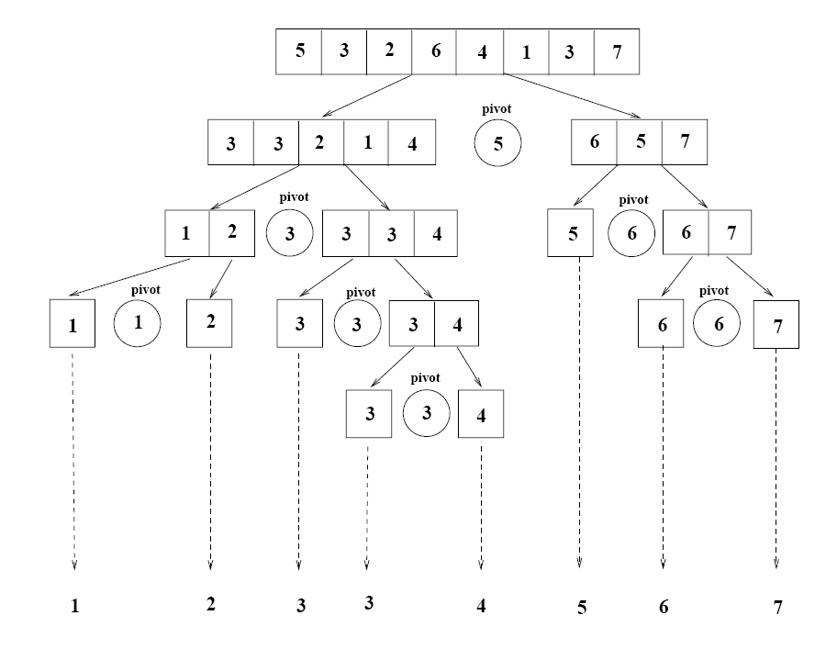
Example

Slide 33
Quick Sort of N elements:
How many comparisons?
(assume balanced splits for simplicity)
N For first call, when each of N elements
is compared to the split value
2 * N/2 For the next pair of calls, when N/2
elements in each “half” of the original
array are compared to their own split values.
4 * N/4 For the four calls when N/4 elements in each
“quarter” of original array are compared to
their own split values.
.
.
. HOW MANY SPLITS CAN OCCUR?

Slide 34
Quick Sort of N elements:
How many splits can occur?
It depends on the order of array elements!
Balanced splits: O(logN) splits → QuickSort is O(N*logN).
Unbalanced splits: O(N) splits → QuickSort is O(N²).
e.g. if the original array was sorted to begin with, the
recursive calls will split up the array into parts of
unequal length, with one part empty, and the
other part containing all the rest of the array except for split value itself.

Slide 35
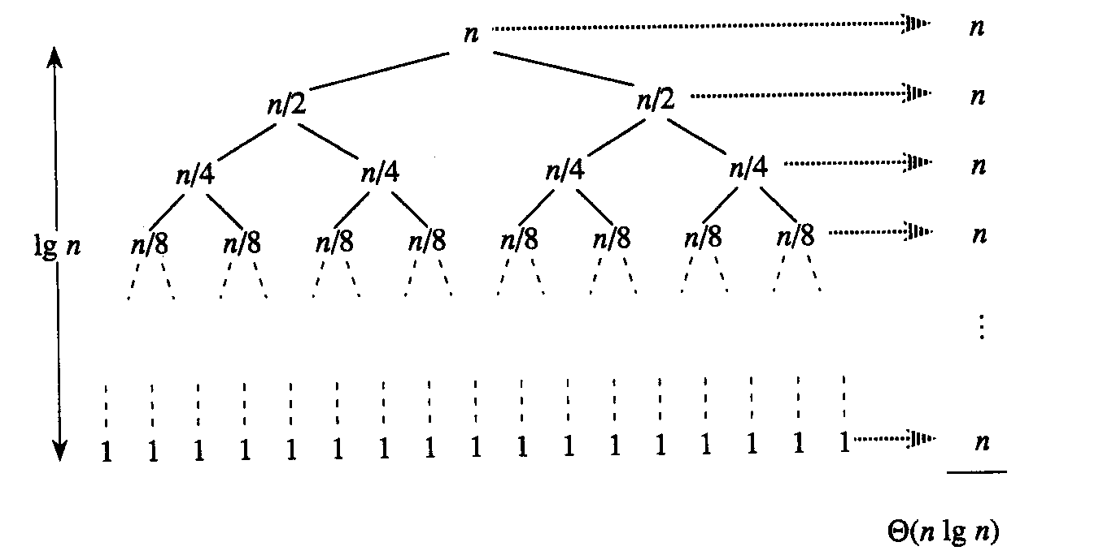
Best case: balanced splits
O(nlogn)

Slide 36
Worst case: unbalanced splits
n
n
1
n - 1
n - 1
1
n - 2
n - 2
O(n)
n
1
n - 3
1
2
2
1
1
1
O(n²)

Slide 37
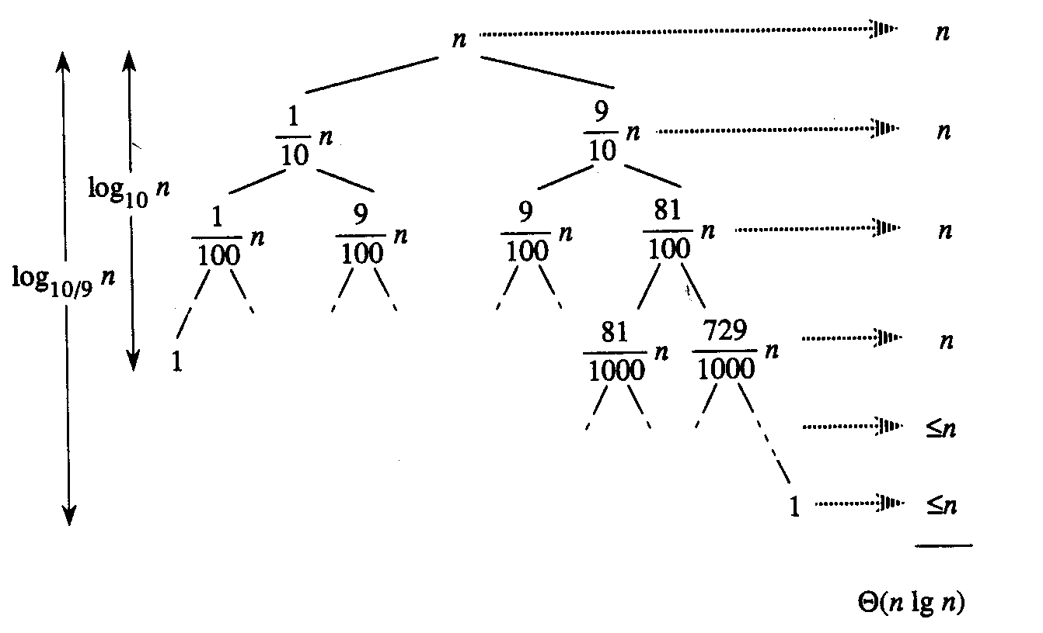
But … is every unbalanced split a bad split?
O(nlogn)
Need to look at split ratio!

Slide 38
Split ratio
O(nlogn)
O(nlogn)
split ratio: (n/2) / (n/2) =const
split ratio: (1/10) / (9/10) =const

Slide 39
Split ratio (cont’d)
n
n
1
n - 1
n - 1
1
n - 2
n - 2
n
1
n - 3
1
2
2
1
1
1
O(n²)
split ratio: n / 1 = n not const

Slide 40
Randomized Quicksort
Randomly permute the elements of the input array before sorting.
Or, choose splitPoint randomly.

Slide 41
Randomized Quicksort
  At each step of the algorithm we exchange element A[p] with an element chosen at random from A[p…r]
  The pivot element x = A[p] is equally likely to be any one of the r – p + 1 elements of the subarray

Slide 42
Randomized Quicksort
Worst case becomes less likely
  Worst case occurs only if we get “unlucky” numbers from the random number generator.
  Randomization can NOT eliminate the worst-case but it can make it less likely!

Slide 43
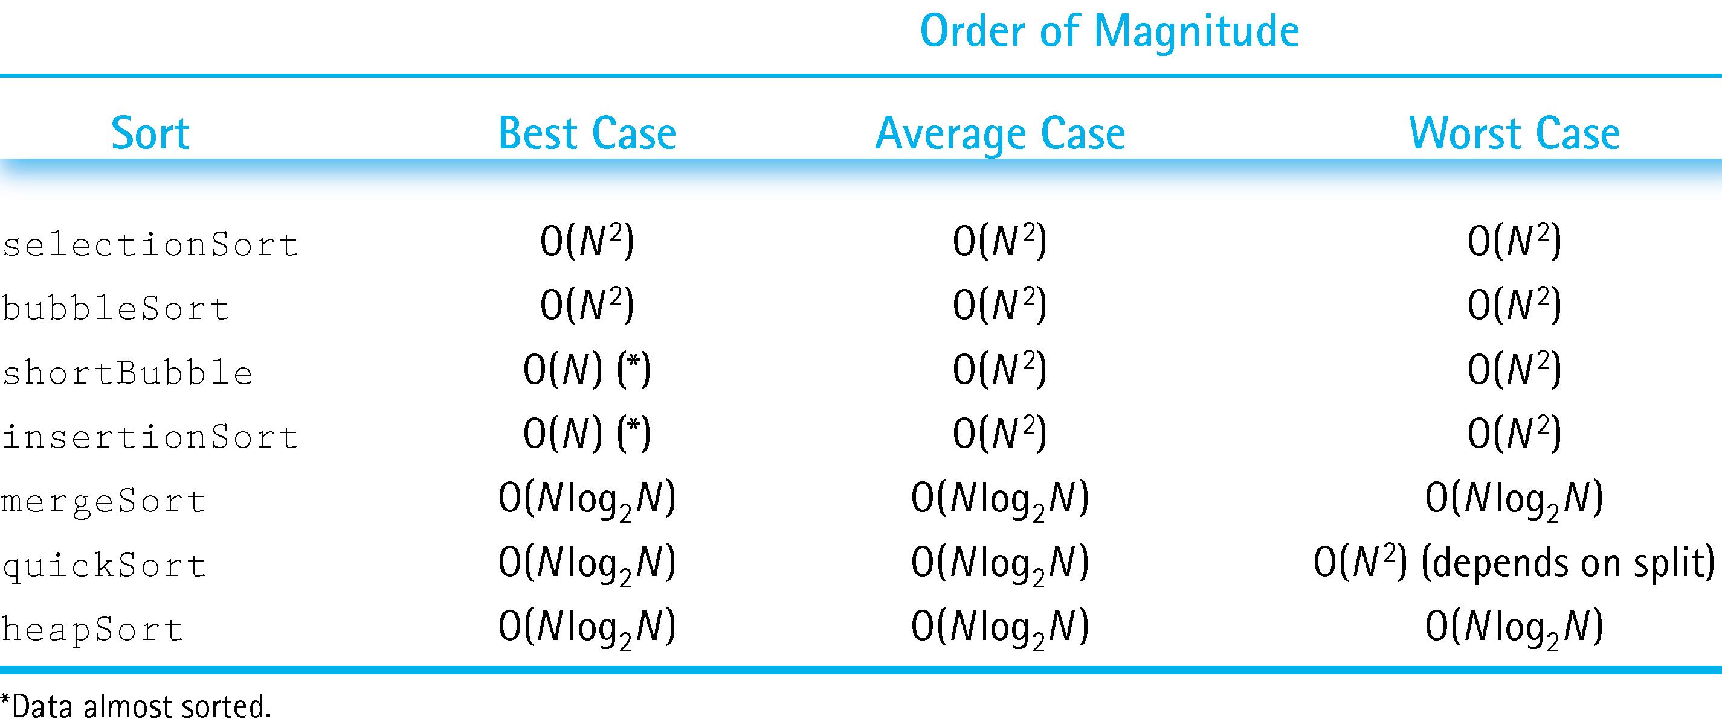
Comparison of Sorting Algorithms

Slide 44
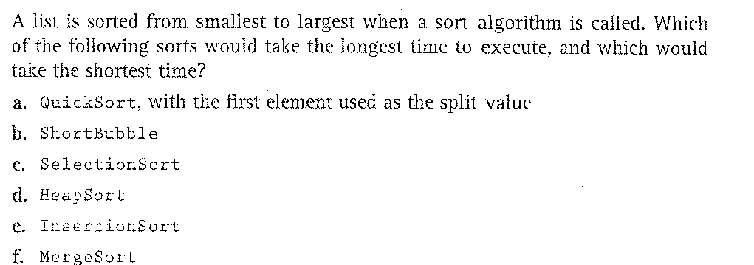
Problems

Slide 45
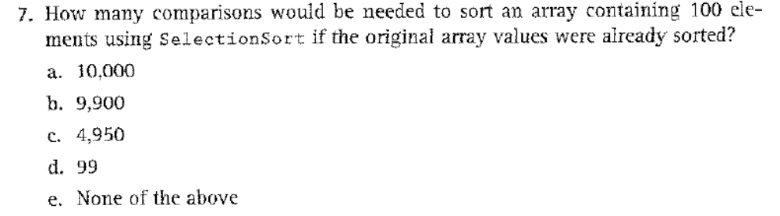
Problems

Slide 46
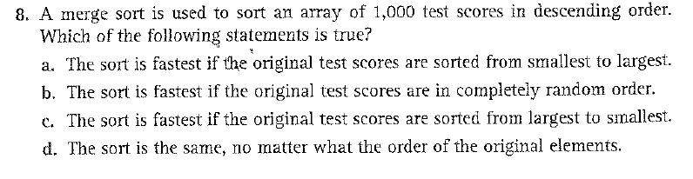
Problems

